Slide 1
Etape Study Results
Should the AWQP calibrate every eTape or can a universal calibration be used?

Slide 2
Uncertainty Study
To justify using a single, universal calibration for each eTape, a comparison study was done to quantify the uncertainty around a single etape calibration
The same, 18” etape was calibrated by 4 student employees
Results were analyzed using the same model form and Bayesian approach.
The remaining slides compare the universal model calibration to the local model calibration

Slide 3
Generic model form
$$Water Depth \left(cm\right)\sim \text{N}\text{(µ, }\text{σ}\text{)}$$
$$\text{µ}=α+β(Ω)$$
Parameter | Mean | SD | 5.5% | 94.5% | Histogram
alpha[1] – eTape length 8” | 28.04 | 0.91 | 26.59 | 29.51 | ▁▁▁▂▅▇▇▅▃▁▁▁▁
alpha[2] – eTape length 12” | 35.98 | 0.27 | 35.55 | 36.42 | ▁▁▂▃▇▇▃▁▁▁
alpha[3] – eTape length 15” | 46.54 | 0.37 | 45.95 | 47.13 | ▁▁▂▃▇▇▇▅▂▁▁▁
alpha[4] – eTape length 18” | 52.06 | 0.29 | 51.62 | 52.52 | ▁▁▁▃▇▇▅▂▁▁▁
alpha[5] – eTape length 24” | 65.97 | 0.62 | 64.99 | 66.94 | ▁▁▁▃▇▇▃▁▁
beta[1] – eTape length 8” | -0.017 | 0.00 | -0.02 | -0.02 | ▁▁▃▇▇▂▁▁
beta[2] – eTape length 12” | -0.016 | 0.00 | -0.02 | -0.02 | ▁▁▁▁▂▃▅▇▇▅▃▂▁▁▁
beta[3] – eTape length 15” | -0.017 | 0.00 | -0.02 | -0.02 | ▁▁▁▂▃▇▇▇▅▃▂▁▁▁
beta[4] – eTape length 18” | -0.017 | 0.00 | -0.02 | -0.02 | ▁▁▁▂▅▇▇▃▂▁▁▁
beta[5] – eTape length 24” | -0.016 | 0.00 | -0.02 | -0.02 | ▁▁▂▃▇▇▃▁▁▁▁
sigma_L | 2.38 | 0.05 | 2.30 | 2.46 | ▁▁▃▇▅▁▁▁

Slide 4
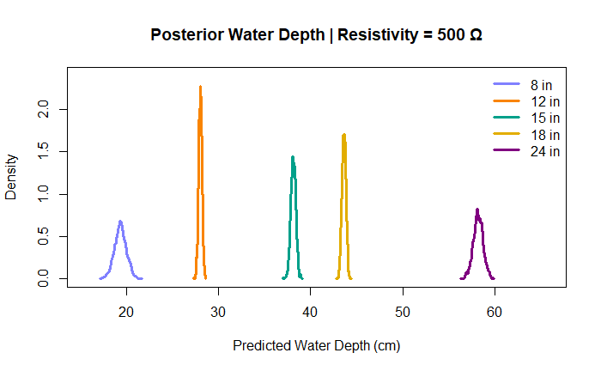
Generative model results for all eTape lengths
eTape Length | Mean | SD | 2.5% | 97.5%
8 | 19.37050 | 0.6432015 | 18.09380 | 20.61520
12 | 28.02889 | 0.1815699 | 27.65329 | 28.38674
15 | 38.11105 | 0.2739453 | 37.58863 | 38.63055
18 | 43.60274 | 0.2165759 | 43.18235 | 44.00805
24 | 58.15743 | 0.5262453 | 57.10703 | 59.21239

Slide 5
All eTapes vs. Single eTape Results
Parameter | Model | Mean | Lower 95% | Upper 95%
alpha | All eTapes | 52.13929160 | 51.66252500 | 52.6349425
alpha | Single eTape | 52.65104030 | 52.34049000 | 52.9643225
beta | All eTapes | -0.01700236 | -0.01727412 | -0.0167306
beta | Single eTape | -0.01762715 | -0.01781120 | -0.0174498

Slide 6
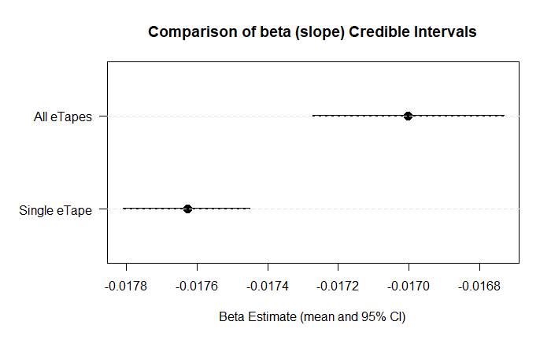
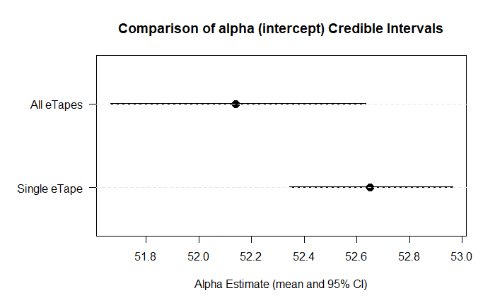
Visual 95% CIs
Intercepts are not different between universal and local models
Slopes are different between universal and local models

Slide 7
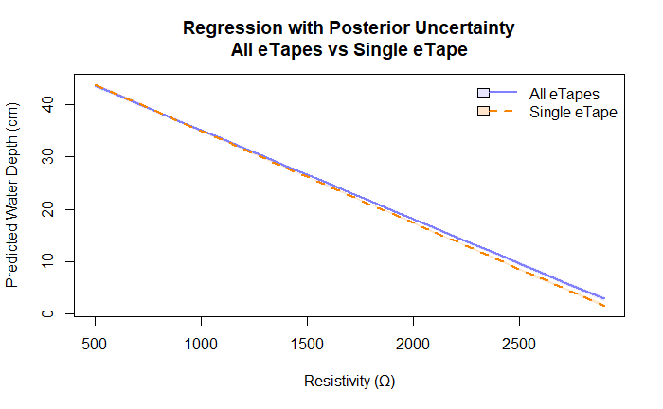
What this looks like in practice

Slide 8
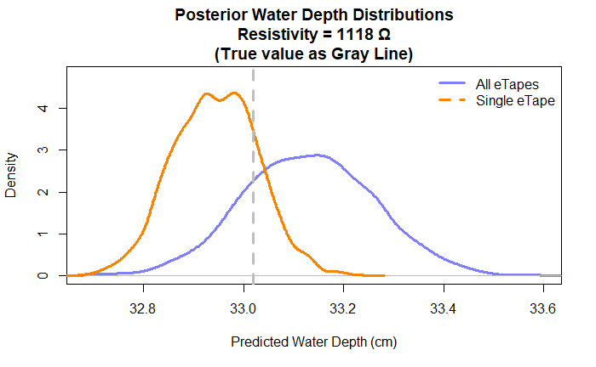
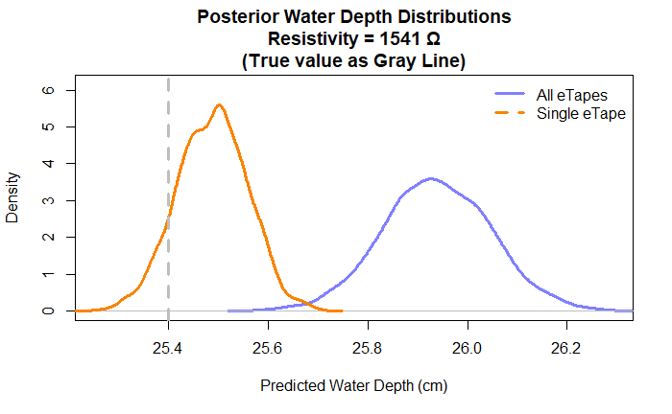
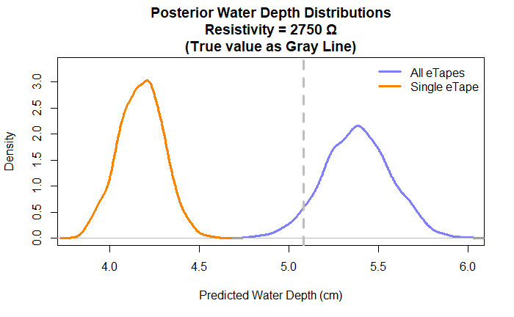
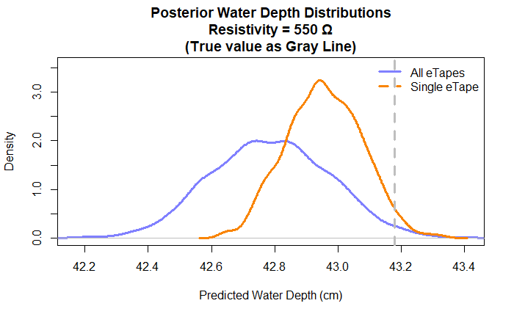
Specific examples with uncertainty

Slide 9
Universal Calibration Results
Tape Length (inches) | Intercept (α) | Slope (β)
8 | 28.0378353 | -0.01726096
12 | 35.9807504 | -0.01590957
15 | 46.540297 | -0.01682064
18 | 52.0602068 | -0.01690116
24 | 65.97030975 | -0.01560485

Slide 10
Summary
Sometimes the local calibration was better
Sometimes the universal calibration was better
Most of the time they had significant overlap
AJ vote: use universal calibration
  That is, a single equation for every eTape length, then use our regular ruler measurements to check if it ever needs local calibration
  This would save time, and acknowledge that the universal calibration is a good enough starting point to use broadly

